Slide 1
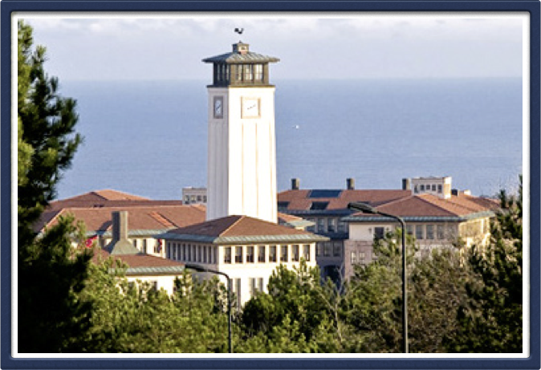
Graphical User Interface

Slide 2
Today’s questions
How can we create graphical programs?

Slide 3
Today’s topics
Review
Graphics

Slide 4
Review

Slide 5
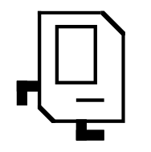
Meet Karel the Robot!
Notes:
Karel – from Karel Chopek, who invented the word “robot”
Old Mac with leg out its back

Slide 6
Karel Knows 4 Commands
move
turn_left
“functions”
put_beeper
pick_beeper

Slide 7
For Loops
Instead, use a for loop:
for i in range(count):
statement
statement
...
Repeats the statements in the body count times.
Notes:
Executes statements in order – NOT repeating each one individually

Slide 8
Control Flow: While Loops
while condition:
statement
statement
...
Repeats the statements in the body until condition is no longer true.
Each time, Karel executes all statements, and then checks the condition.
Notes:
Karel can ask some questions about its world / surroundings

Slide 9
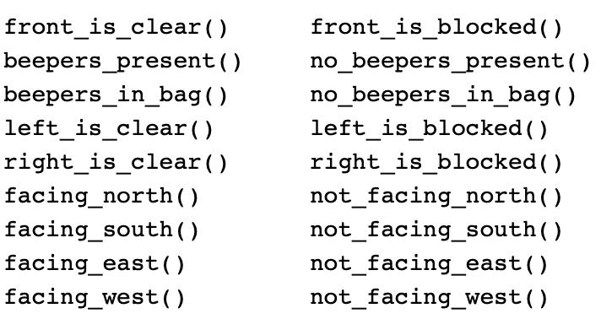
Possible Questions
This is taken from the Karel Reference.

Slide 10
If/Else Statements
What if we want to do one thing if some condition is true, and another otherwise? We can add an else statement:
if condition:
statement
statement
...
elif condition:
statement
statement
else:
statement
statement
...

Slide 11
Top-Down Design - Decomposition
Start from a large task and break it up into smaller pieces
Ok to write your program in terms of commands that don’t exist yet
Goal: make our programs easily readable by humans
Commenting
Decomposition
E.g. Going to the moon

Slide 12
Using Python
Python must be installed and configured prior to use
One of the items installed is the Python interpreter
Python interpreter can be used in two modes:
Interactive mode: enter statements on keyboard
Script mode: save statements in Python script

Slide 13
Create, Modify, Use
# Create a variable, of type int
# called age with the value 30.
age = int(input(‘What is your age: ‘))
# Modify age to be one greater.
age = age + 1
# Use the value in age (output it)
print(“age is: ” + age)

Slide 14

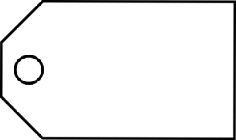
Variable Analogy
num_students = 700
num_students
int
700
name
type
value

Slide 15
input function
num1 = input("Enter first number: ")
input command gets text input from the user
Prints text specified in double/single quotes
Then waits for user input
Here, user input from input is put in a variable (num1)
The user input is considered text, even if user entered a number

Slide 16
All Python objects have a type!
Types
Integers - numbers with no decimals
num_flowers = 5
Floats - numbers with decimals
fraction = 0.2
Booleans - true or false
is_raining_today = True
Strings - collection of characters
myName = ‘Ayca’

Slide 17
Binary Operators
+
Addition
*
Multiplication
–
Subtraction
/
Division
There are others too!
%
Remainder
//
Int Division
**
Exponentiation

Slide 18
Comparison Operators
Operator | Meaning | Example | Value
== | equals | 1 + 1 == 2 | True
!= | does not equal | 3.2 != 2.5 | True
< | less than | 10 < 5 | False
> | greater than | 10 > 5 | True
<= | less than or equal to | 126 <= 100 | False
>= | greater than or equal to | 5.0 >= 5.0 | True
* All have equal precedence

Slide 19
Random Integers
Minimum value
secret_number = random.randint(1, 99)
Maximum value
Minimum and max values are includes

Slide 20
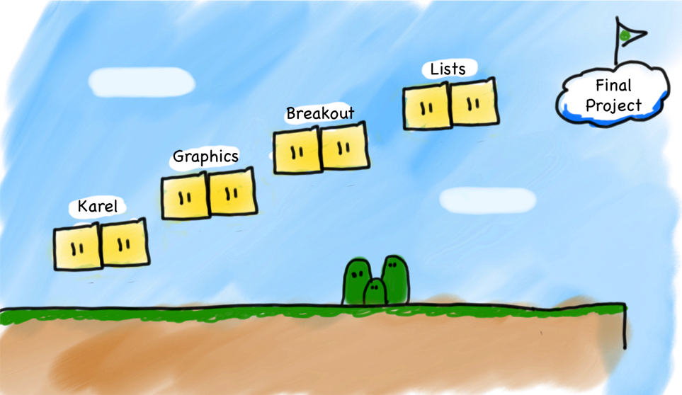
What have we learned so far?
Breakout
Graphics
Console
Karel
Notes:
Same material as Stanford’s class

Slide 21
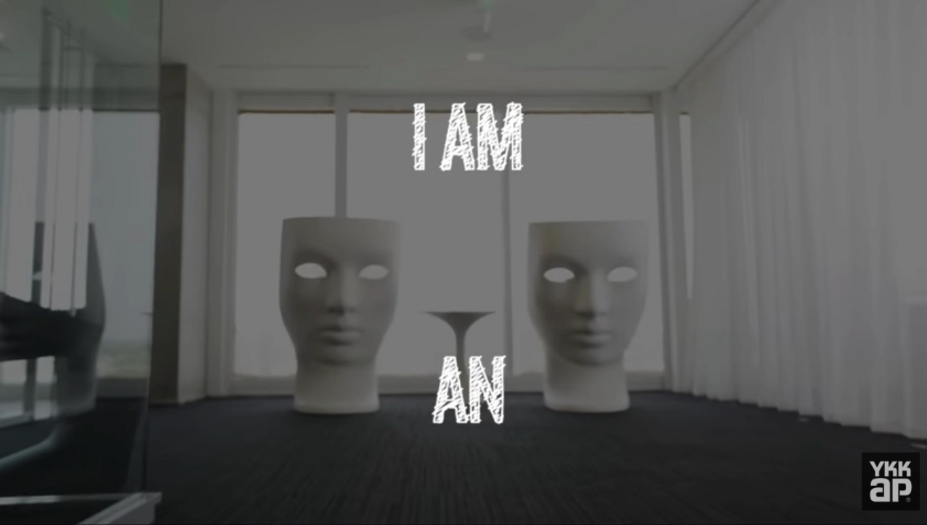
Fun fact!

Slide 22
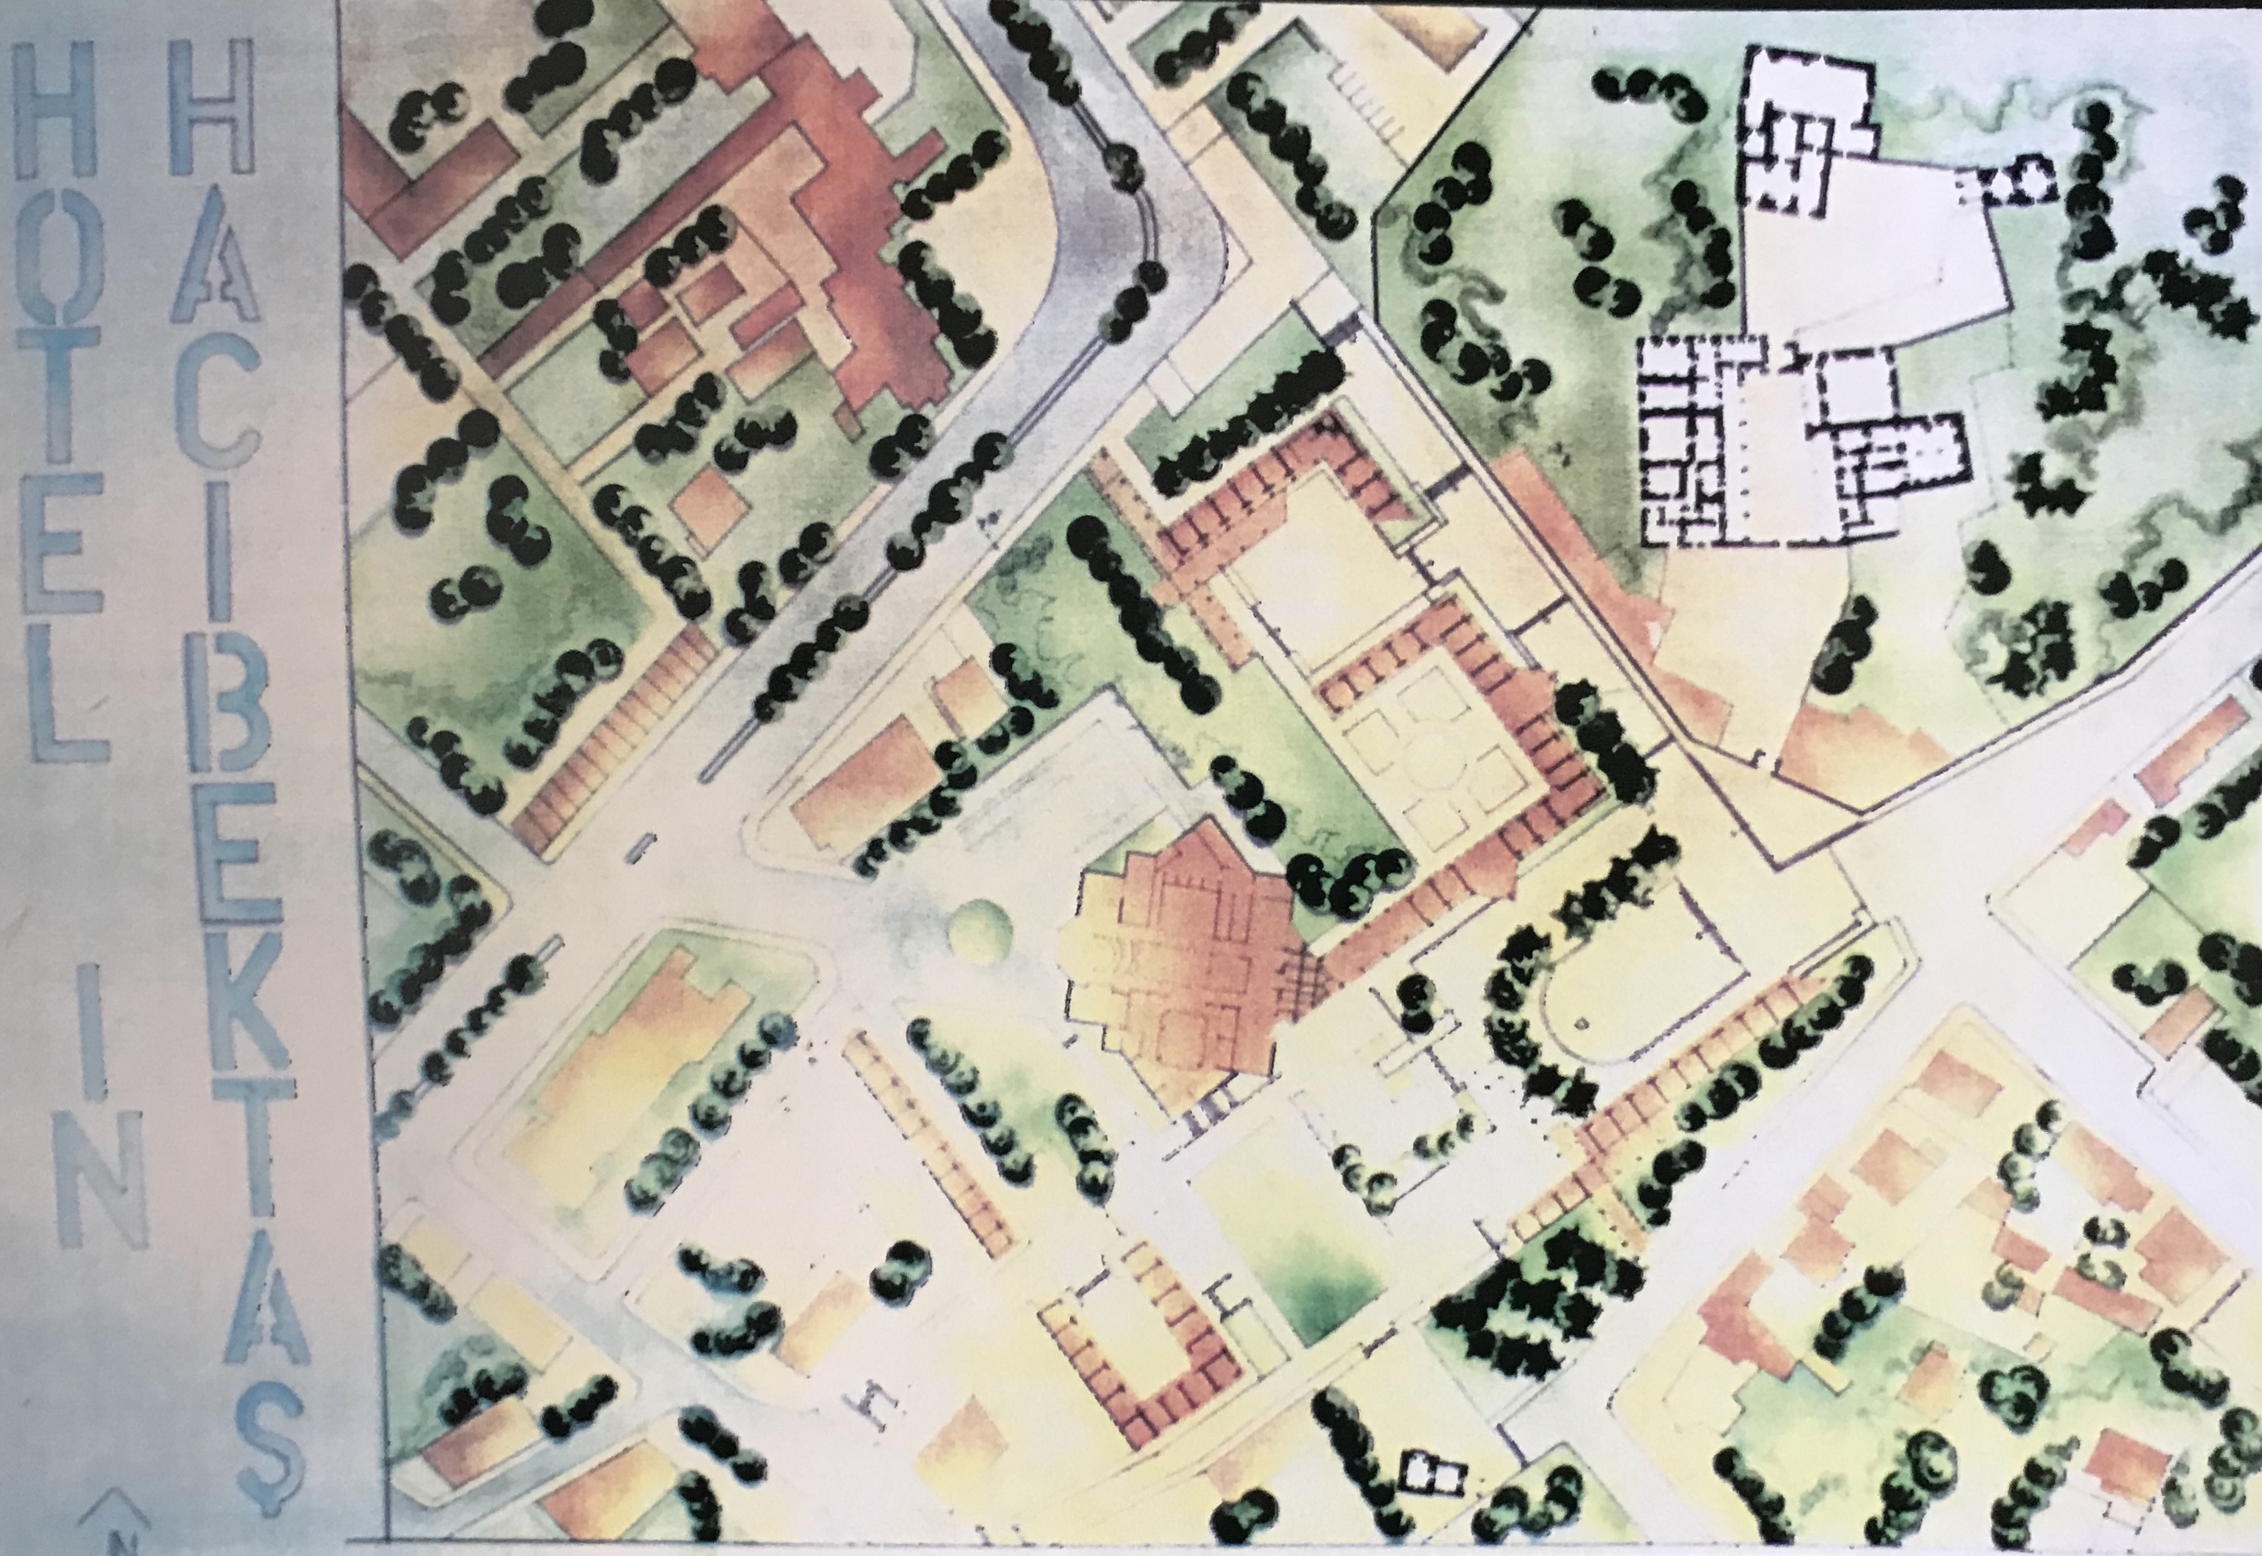
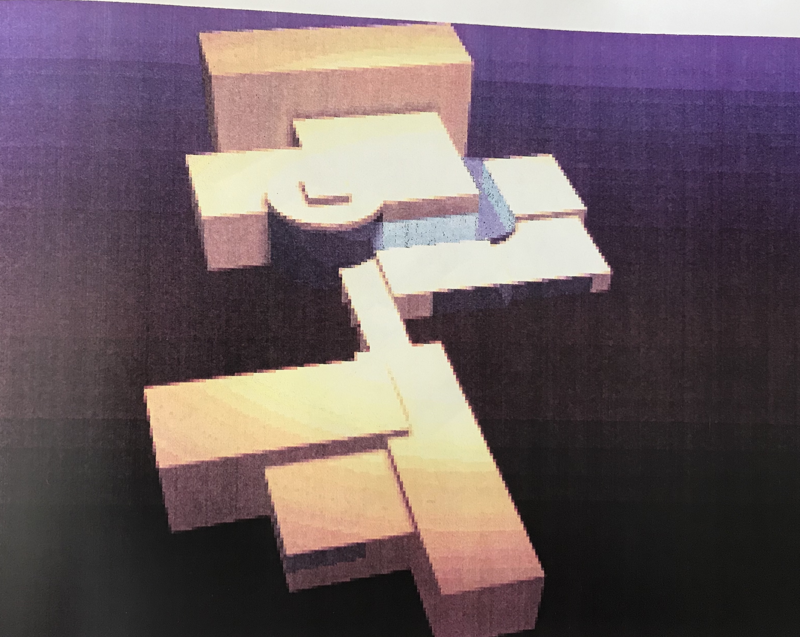
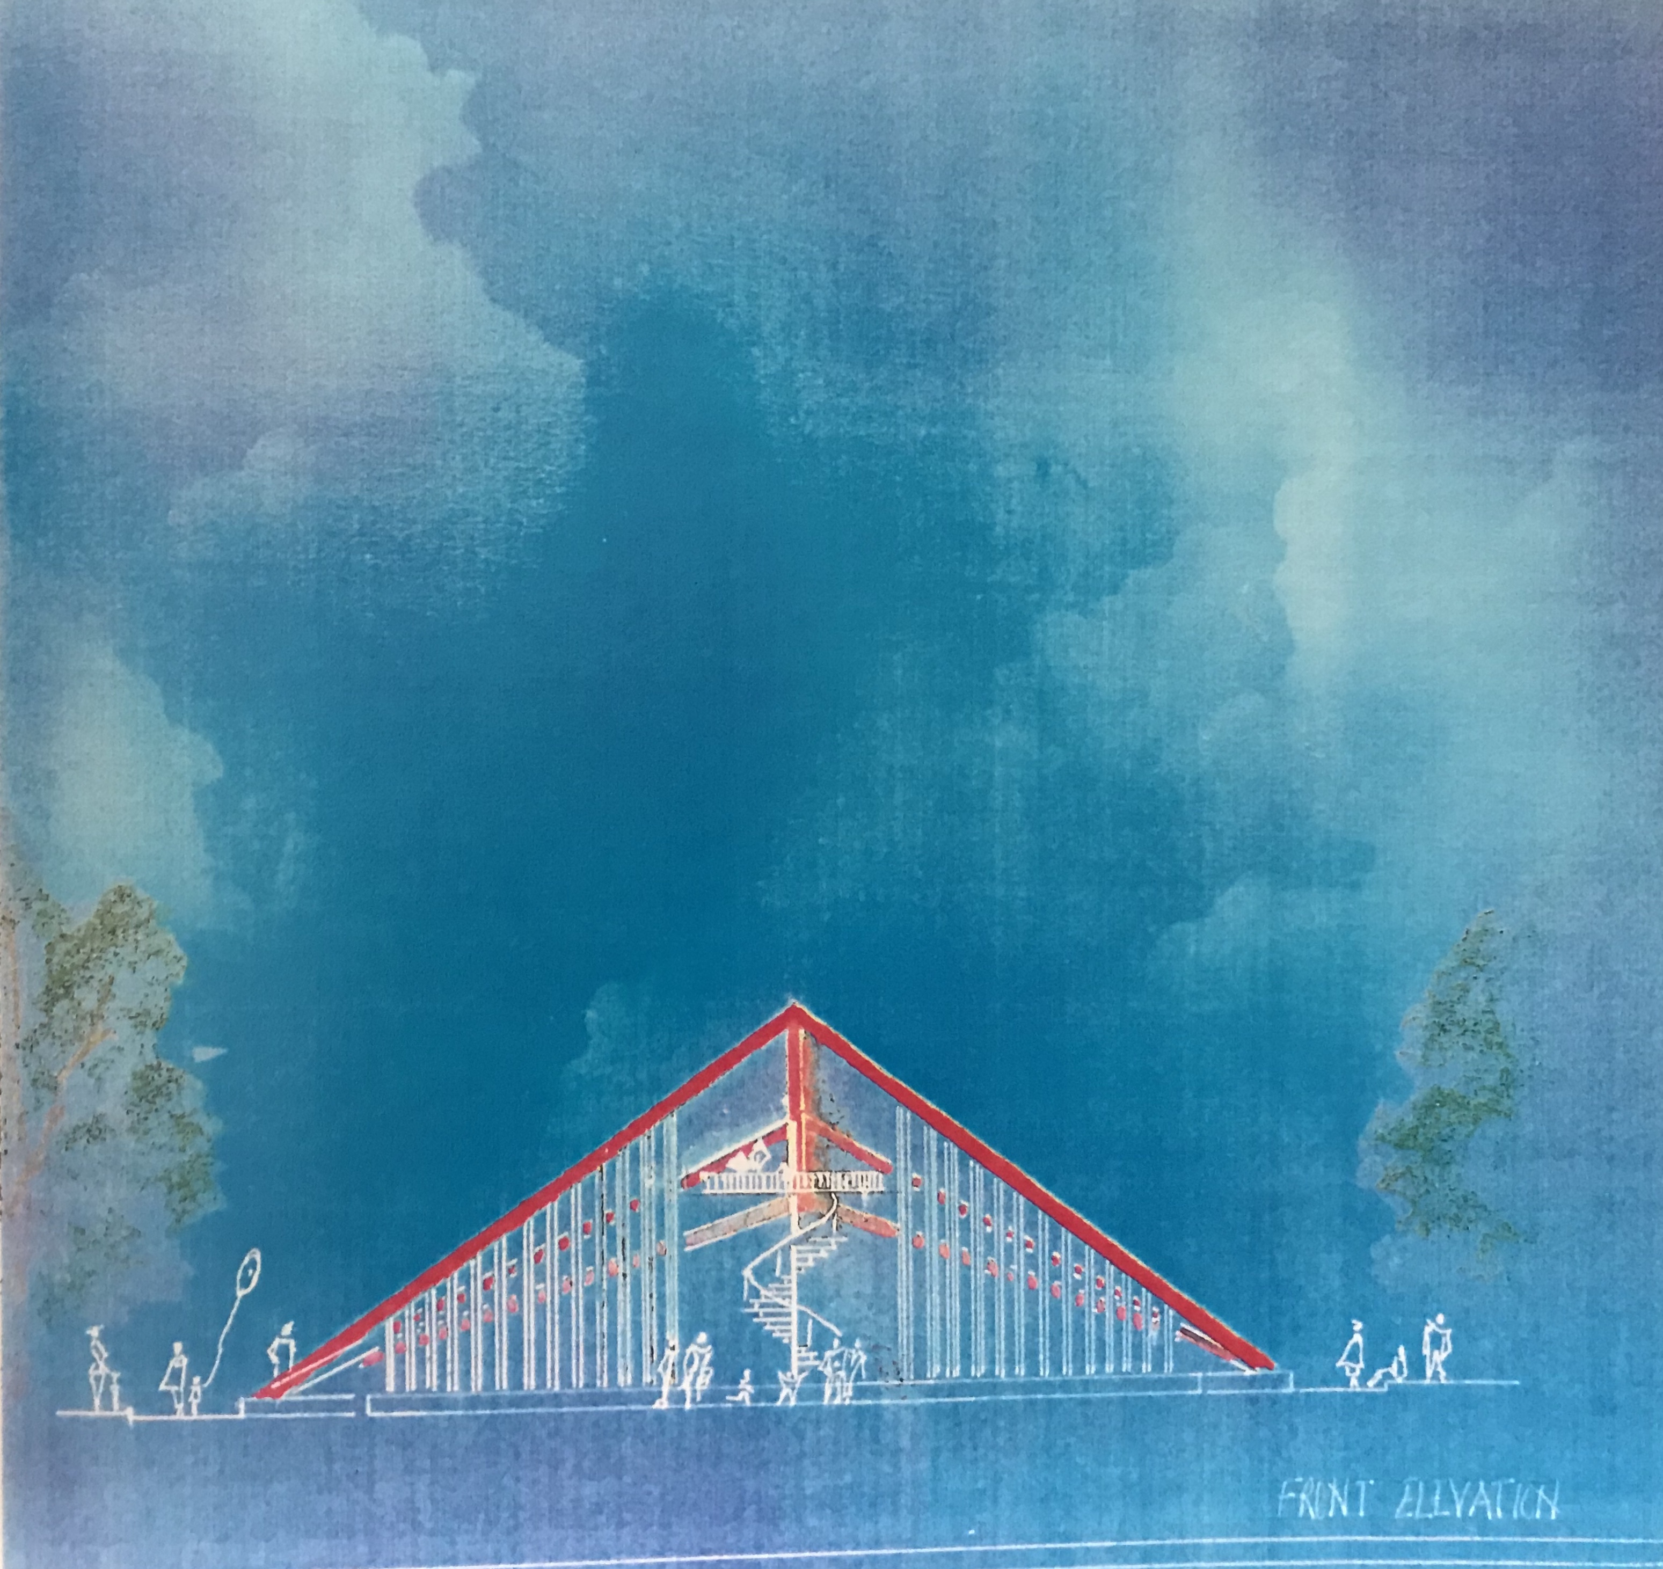
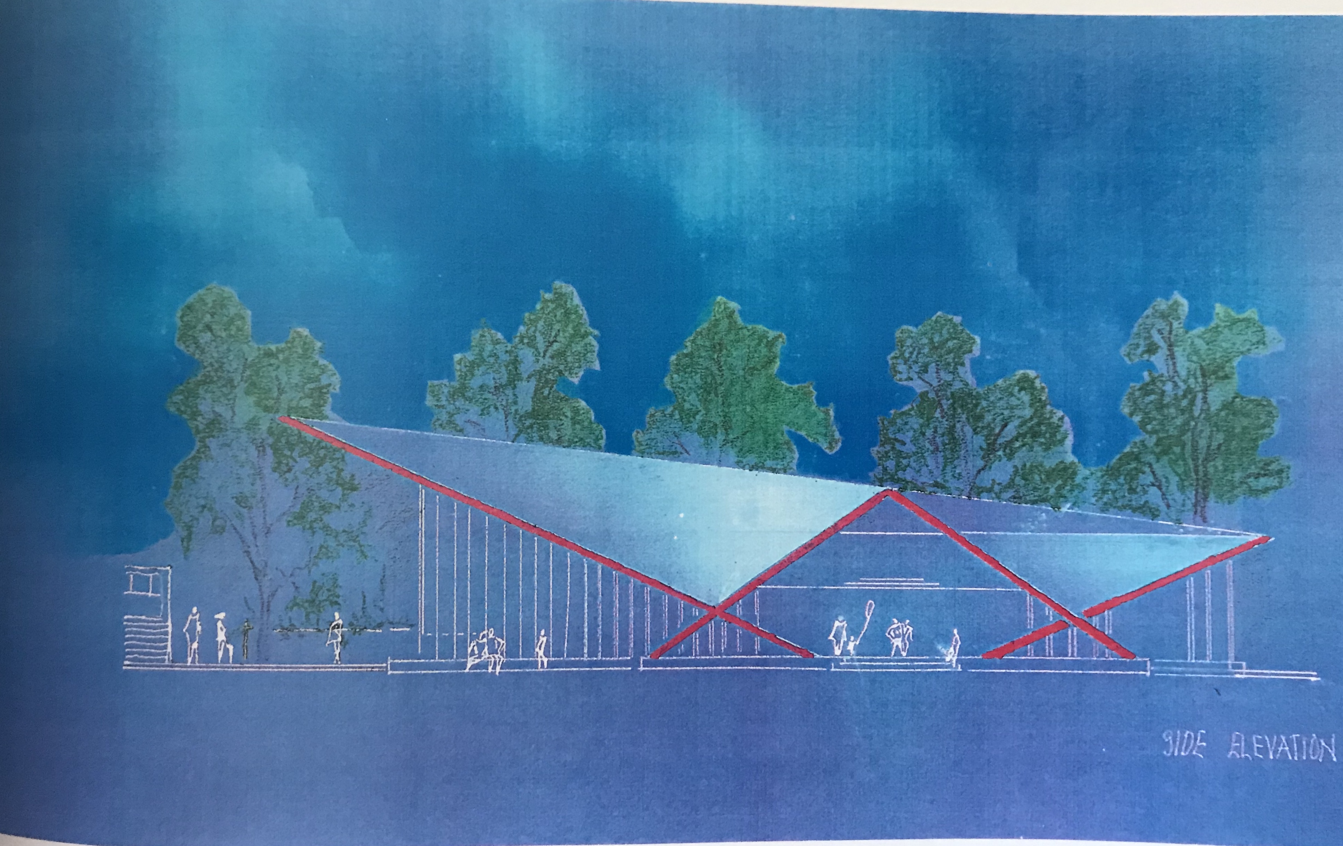
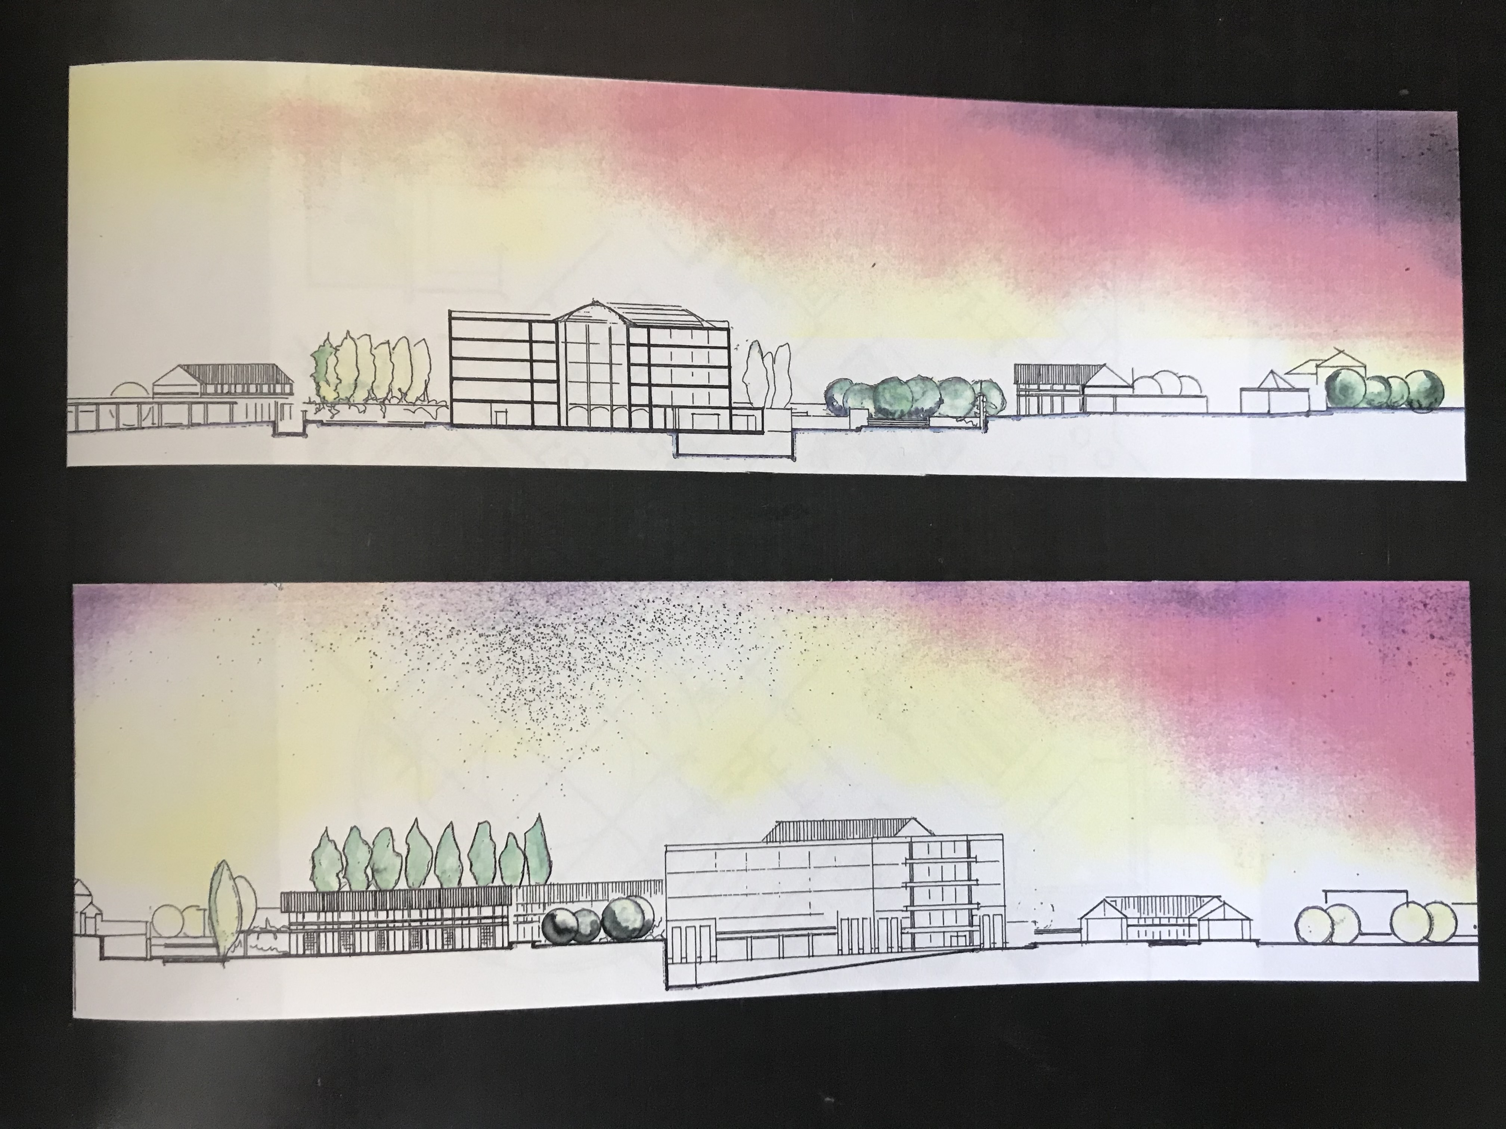
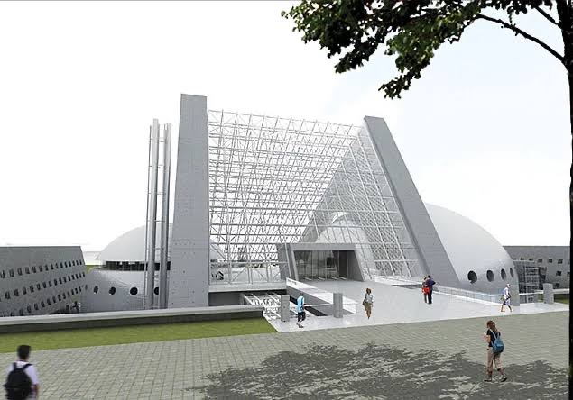
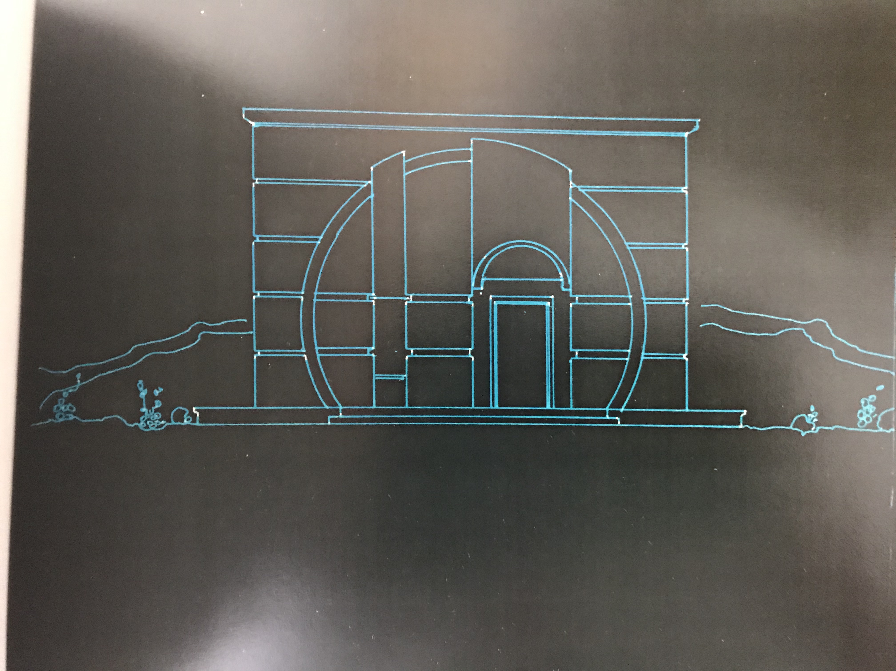
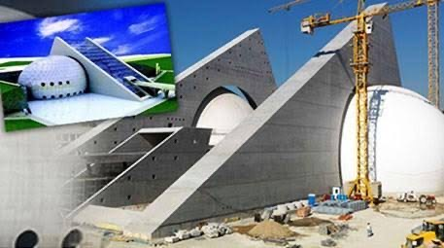

Slide 23
How can we generate graphical programs?
GUI libraries (modules)!

Slide 24
Definition
Graphical User Interface (GUI)
Visual elements that you interact with within applications (windows, buttons, scroll bars, etc.)

Slide 25
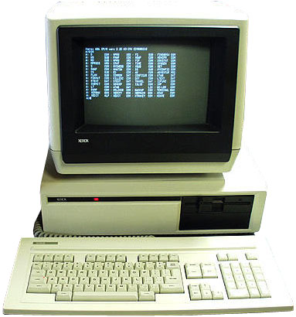
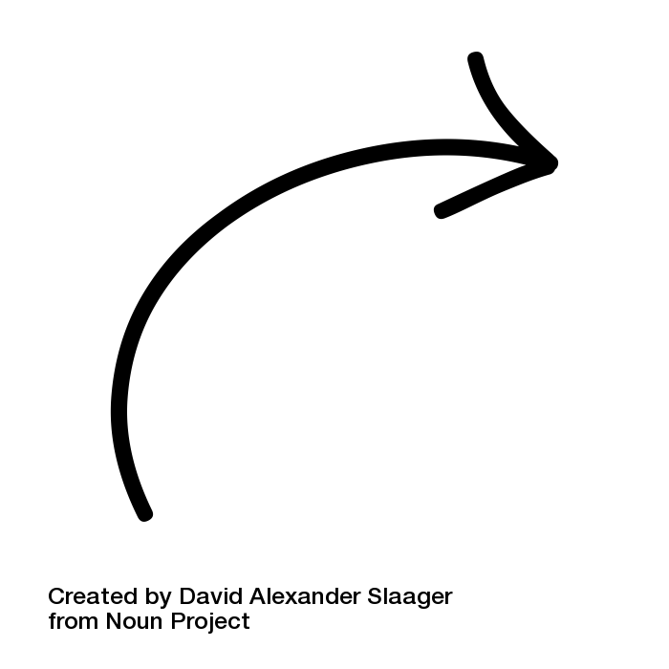
Console - Command Line
No GUI! All text-based (Old computers used to only have a command line!)

Slide 26
Gui - Event Driven Program
In text-based environments, programs determine the order in which things happen
The user can only enter data in the order requested by the program
GUI environment is event-driven
The user determines the order in which things happen
User causes events to take place and the program responds to the events

Slide 27
How does computer graphics get created?

Slide 28
Gui - Event Driven Program
Windows, Mac OS, Linux each have their own GUI systems
GUI libraries are modules that support the GUI (i.e. their functions allow you to interact with your computer’s GUI system)
tkinter is Python’s standard GUI package
Many other GUI libraries are built on top of tkinter!

Slide 29
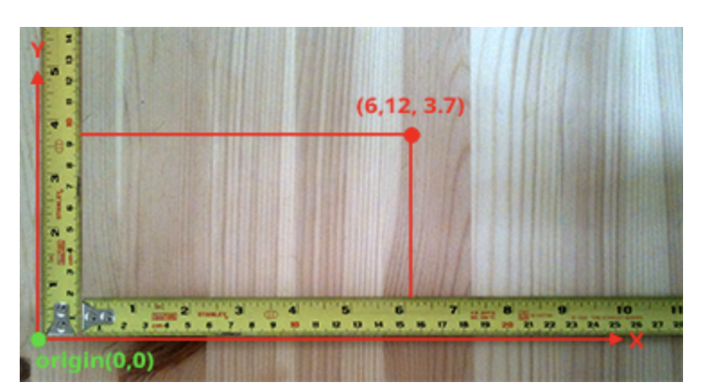
Drawing in Real Life
Draw objects using Cartesian coordinate system

Slide 30
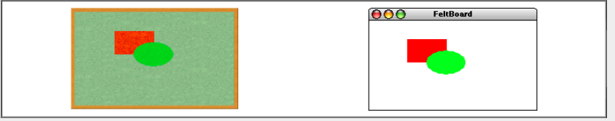
Drawing Computer Graphics
When creating computer graphics we first somehow describe the shape (and the appearance) of objects
Place objects on a background called “Canvas”
Similar to “Felt board” metaphor -
The underlying model is similar to that of a collage in which an artist creates a composition by taking various objects and assembling them on a background canvas.

Slide 31
Canvas
Everything gets drawn on a canvas
In today’s examples, we’ll provide the code for creating the canvas.
x
(0,0)
y

Slide 32
Canvas
0,0
40,20
120,40
CANVAS_HEIGHT
40,120
CANVAS_WIDTH

Slide 33
Canvas
the following main creates a canvas with kitle with default size
def main():
canvas = Canvas()
)

Slide 34
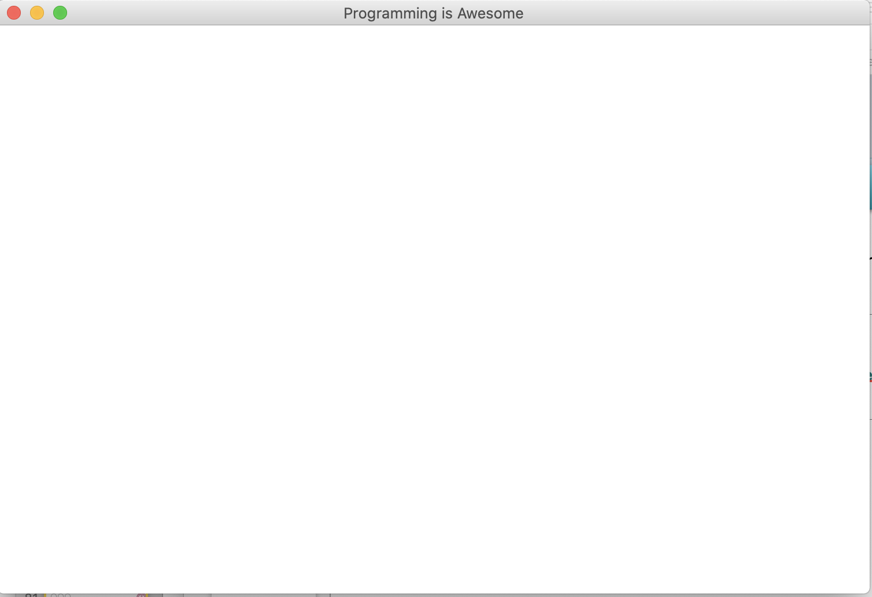
Canvas
the following main creates a canvas with kitle with default size
def main():
canvas = Canvas()
canvas.set_canvas_title("Programming is Awesome")
)

Slide 35
Canvas
the following main creates a canvas with kitle with default size
def main():
canvas = Canvas(800, 600)
canvas.set_canvas_title("Programming is Awesome")
)

Slide 36
How do we draw simple shapes?

Slide 37
Drawing Simple Shapes
canvas.create_text()
canvas.create_line()
canvas.create_rectangle()
canvas.create_oval()

Slide 38
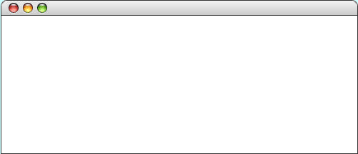
Draw a Rectangle
the following main method displays a blue square
def main():
canvas = Canvas(800, 200)
canvas.set_canvas_title(“Hello Rect”)
)
Hello Rect

Slide 39
Draw a Rectangle
the following main method displays a blue square
def main():
canvas = Canvas(800, 200)
canvas.set_canvas_title(“Hello Rect”)
)
Hello Rect
800 pixels wide

Slide 40
Draw a Rectangle
the following main method displays a blue square
def main():
canvas = Canvas(800, 200)
canvas.set_canvas_title(“Hello Rect”)
)
Hello Rect
200 pixels tall

Slide 41
Draw a Rectangle
the following main method displays a blue square
def main():
canvas = Canvas(800, 200)
canvas.set_canvas_title(“Hello Rect”)
)
Hello Rect

Slide 42
Draw a Rectangle
the following main method displays a blue square
def main():
canvas = Canvas(800, 200)
canvas.set_canvas_title(“Hello Rect”)
canvas.create_rectangle(20, 20, 100, 100)
)
Hello Rect
20, 20

Slide 43
Draw a Rectangle
the following main method displays a blue square
def main():
canvas = Canvas(800, 200)
canvas.set_canvas_title(“Hello Rect”)
canvas.create_rectangle(20, 20, 100, 100)
)
Hello Rect
100, 100

Slide 44
Draw a Rectangle
the following main method displays a blue square
def main():
canvas = Canvas(800, 200)
canvas.set_canvas_title(“Hello Rect”)
canvas.create_rectangle(20, 20, 100, 100)
)
Hello Rect
Aside: Named Arguments
This argument is named as filled. It allows functions to have arguments which you can ignore if you want a default value.
This is white

Slide 45
Draw a Rectangle
the following main method displays a blue square
def main():
canvas = Canvas(800, 200)
canvas.set_canvas_title(“Hello Rect”)
canvas.create_rectangle(20, 20, 100, 100)
canvas.mainloop()
Hello Rect
Mainloop is a method will loop forever, waiting for events from the user, until the user exits the program

Slide 46
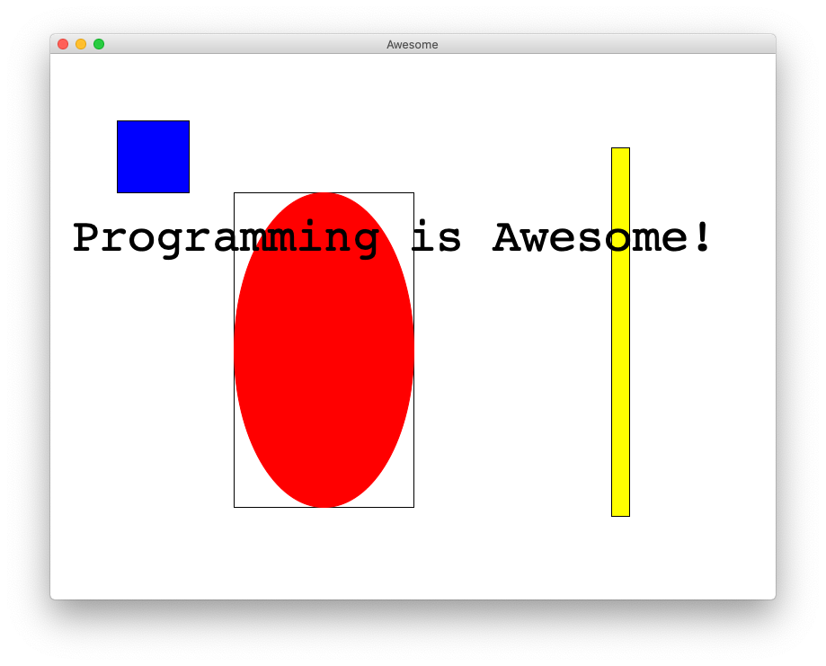
Rectangle, Oval and Text

Slide 47
Drawing Line
canvas.create_line(x1, y1, x2, y2)

Slide 48
Drawing Line
canvas.create_line(x1, y1, x2, y2)
(x1, y1)
(x2, y2)

Slide 49
Drawing Oval
canvas.create_oval(x1, y1, x2, y2)
(x1, y1)
(x2, y2)

Slide 50
Drawing Line
canvas.create_line(x1, y1, x2, y2)
(x1, y1)
(x2, y2)

Slide 51
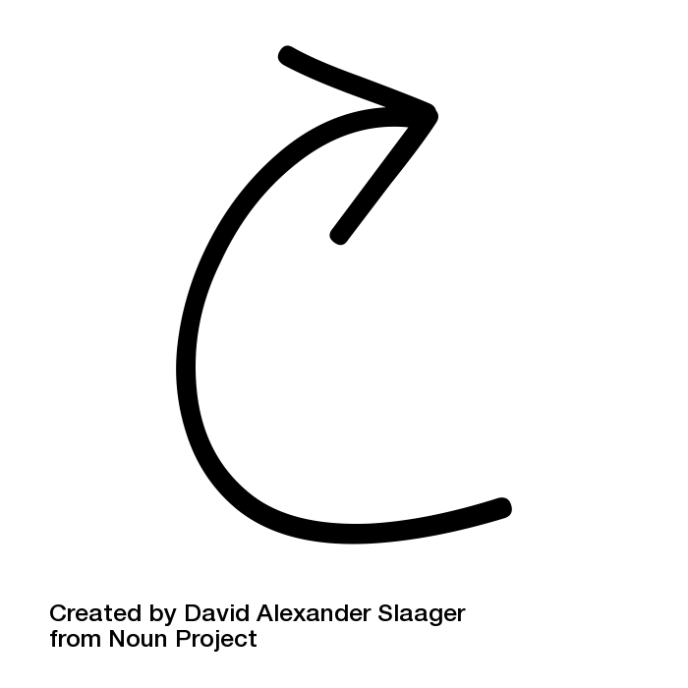
Drawing Oval
canvas.create_oval(x1, y1, x2, y2)
(x1, y1)
(x2, y2)

Slide 52
Drawing Text
canvas.create_text(x, y, ’hi’)
hi
(x, y)

Slide 53
Proportional math:
draw_pyramid()

Slide 54
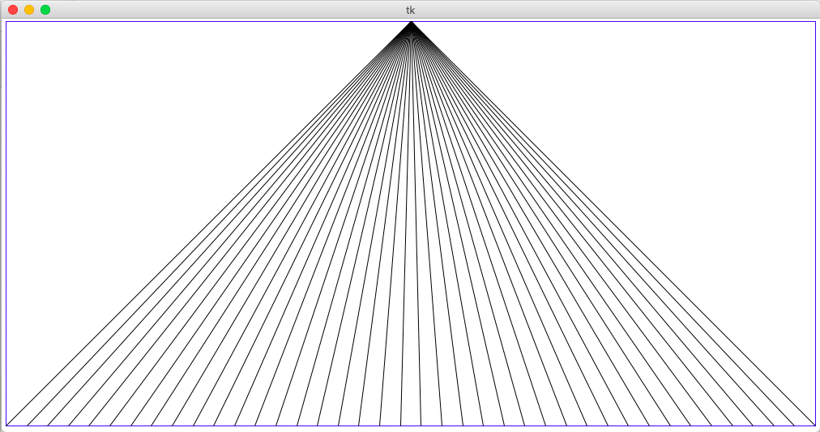
draw_pyramid()
[demo]

Slide 55

Drawing Image
canvas.create_image(x, y, “name of the file”)
(x, y)

Slide 56
Get Canvas Information
def main():
canvas = Canvas(800, 200)
canvas.set_title(‘My Program’)

Slide 57
Get Canvas Information
def main():
canvas = Canvas(800, 200)
canvas.set_title(‘My Program’)
canvas_width = canvas.get_canvas_width()
canvas_height = canvas.get_canvas_height()

Slide 58
Get Canvas Information
def main():
canvas = Canvas(800, 200)
canvas.set_title(‘My Program’)
canvas_width = canvas.get_canvas_width()
canvas_height = canvas.get_canvas_height()
#create centered text
Label = canvas.create_text(canvas_width /2, canvas_height/2, ‘I am centered’)

Slide 59
Get Object Information
def main():
canvas = Canvas(800, 200) rect = canvas.create_rectangle(5, 10, 50, 100) print(canvas.get_width(rect) #print 50
print(canvas.get_height(rect) #print 100
print(canvas.get_left_x(rect) #print 5
print(canvas.get_top_y(rect) #print 10

Slide 60
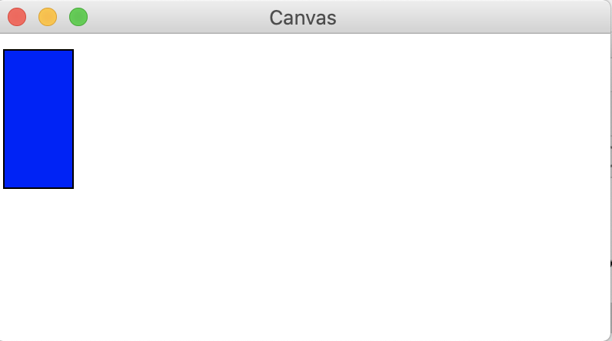
Update Object Information
def main():
canvas = Canvas(400, 200)
canvas.set_title(‘My Program’) rect = canvas.create_rectangle(5, 10, 50, 100)

Slide 61
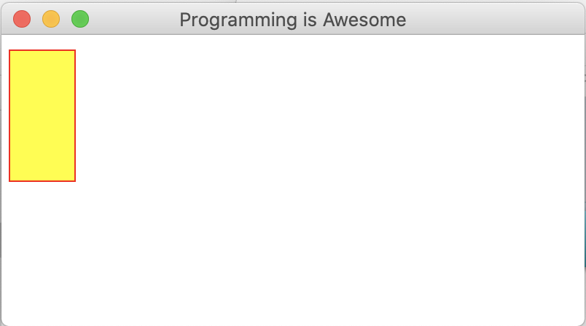
Update Object Information
def main():
canvas = Canvas(400,200)
canvas.set_title(‘My Program’) rect = canvas.create_rectangle(5, 10, 50, 100) canvas.set_outline_color(rect, ‘red’)
canvas.set_fill_color(rect, ‘yellow’)

Slide 62
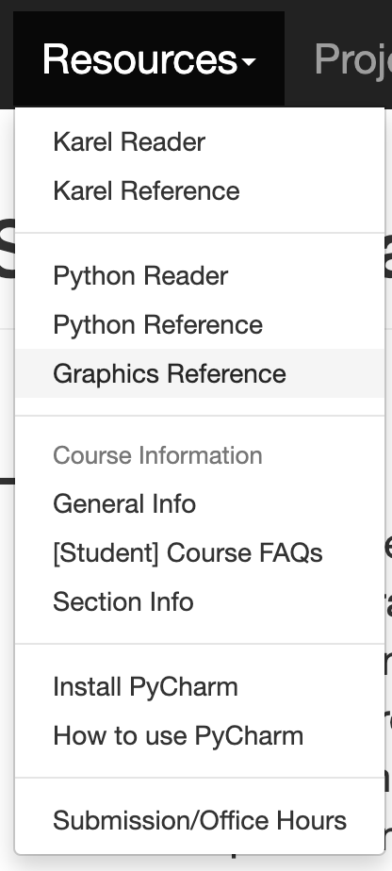
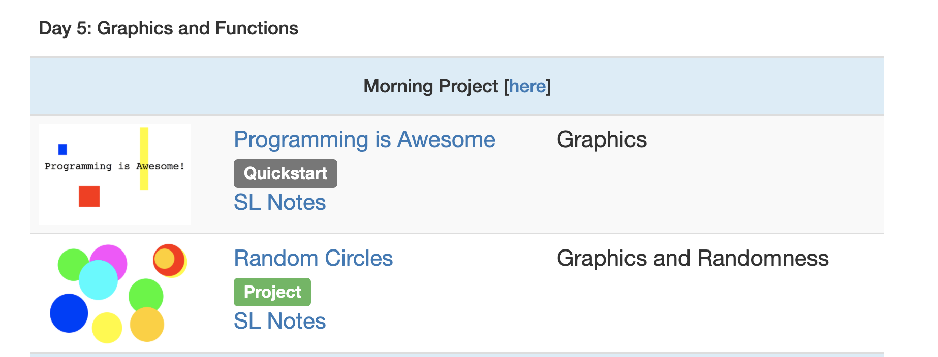
What is next?

